Slide 1

Chapter 15. Record Management
Database Design and Implementation
Edward Sciore, Boston College
ISBN: 978-0-471-75716-0
Presented by Liping Guan
liping0223@korea.ac.kr
Data Intelligence Laboratory, Korea University
31th March, 2015

Slide 2
Outline
15.1 The Record Manager
15.2 Implementing a File of Records
15.3 The SimpleDB Record Manager

Slide 3
15.1 The Record Manager
The record manager is the portion of the database system that is responsible for storing records in a file.
Spanned vs. Unspanned Records
Homogeneous vs. Nonhomogenous Files
Fixed-Length vs. Variable-Length Fields

Slide 4
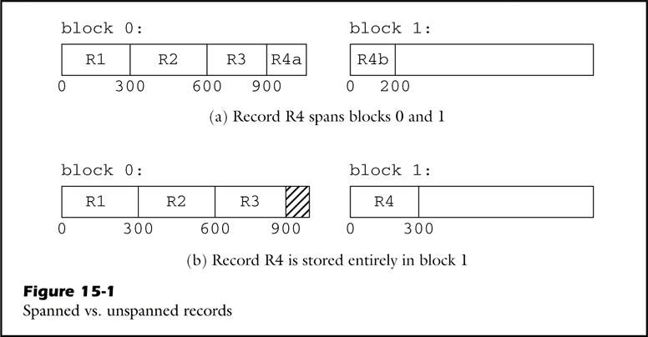
Spanned vs. Unspanned Records
There are four 300 bytes records: R1, R2, R3, R4
Block size: 1000 bytes
Option 1:
Use span block
Option 2:
Create new block
waste
Notes:
Advantage: no disk space is waste
record is not bound by block size if record size > block size
Disadvantage: more complexity, blocks need to be read and record may need reconstructed

Slide 5
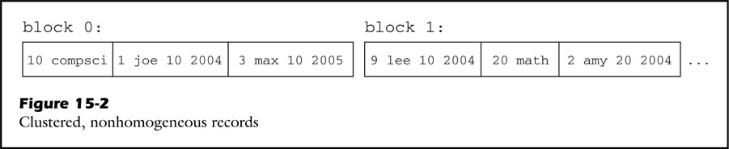
Homogeneous vs. Nonhomogeneous Files
A file is homogeneous if all of its records come from the same table
Homogeneous: easy to SQL, multi-table less efficiency, repeat search
Nonhomogeneous: improve efficiency by join table, single-table less efficiency
Department table Student table

Slide 6
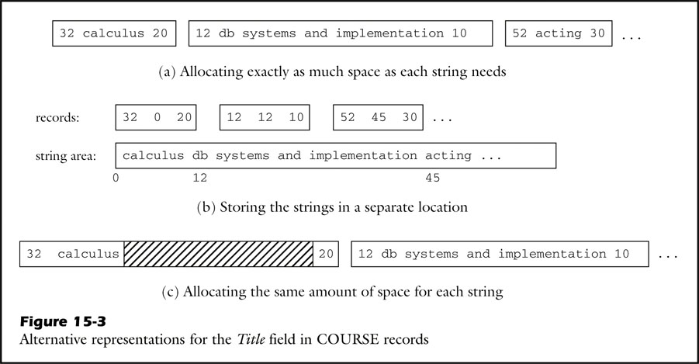
Fixed-Length vs. Variable-Length Fields
A fixed-length field representation uses the same number of bytes to hold
each value of the field. COURSE(course_id, title , department_id )
Variable-Length
Fixed-Length
Notes:
Course id, title , department id

Slide 7
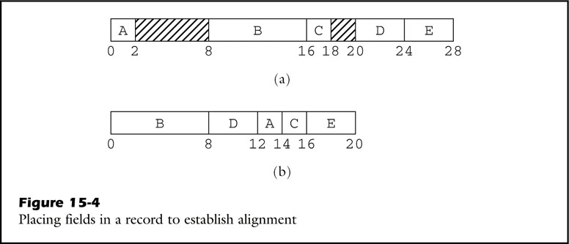
Placing Field in Records
The record manager pads fields so that each field is aligned on an appropriate
byte boundary.
Create table T (A smallint, B double precision, C smallint, D int, E int )
2-bytes 8-bytes 2-bytes 4-bytes 4-bytes

Slide 8
15.2 Implementing a File of Records
A straightforward implementation
Implementing Variable-Length Fields
Implementing Spanned Records

Slide 9
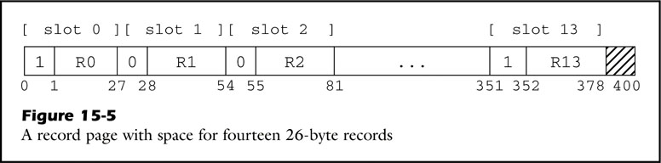
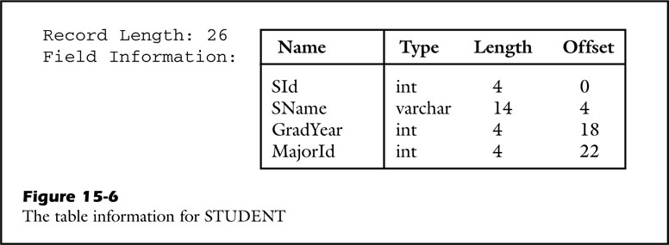
A straightforward implementation
A record page is a block that is structured as an array of fix-length records.

Slide 10
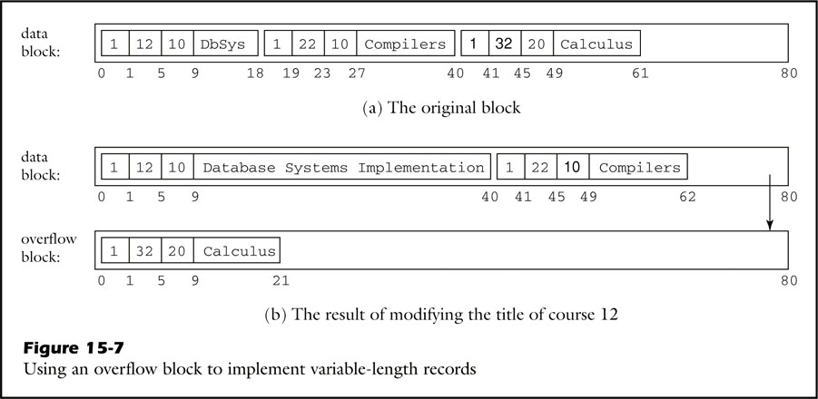
Implementing Variable-Length Fields
Modify course name
reference

Slide 11
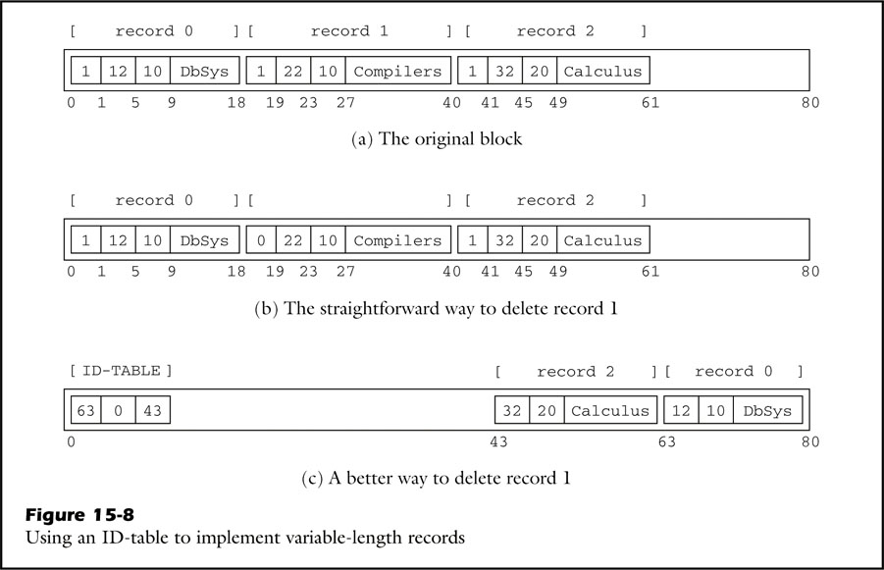
Implementing Variable-Length Fields
Use ID-table

Slide 12
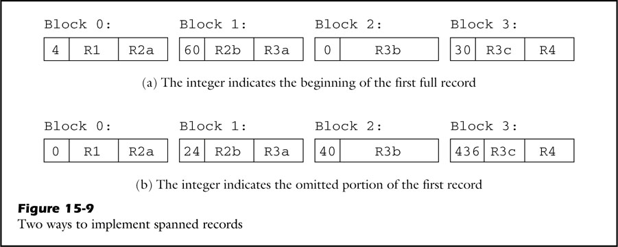
Implementing Spanned Records
First： number means begin of new first record
Second: number of bytes in previous block for first record

Slide 13
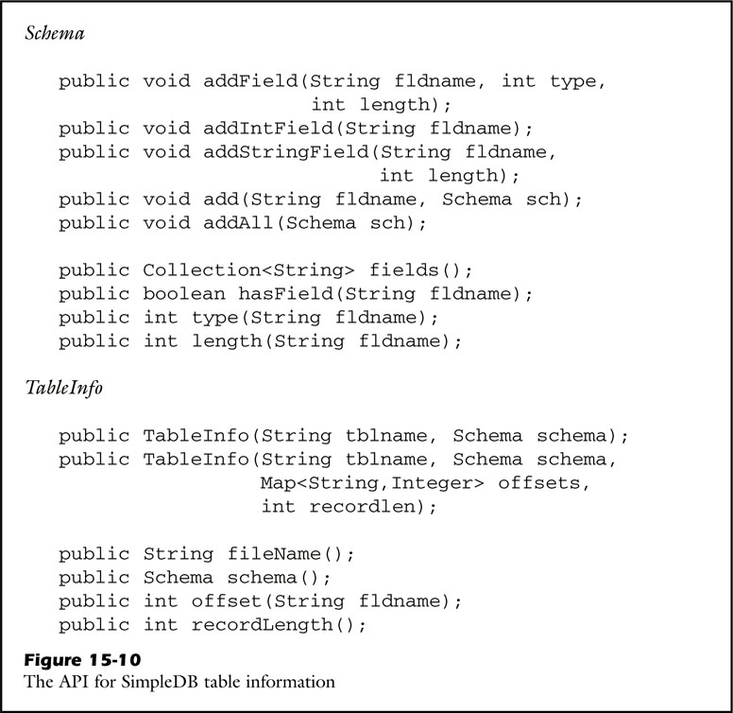
15.3 The SmpleDB Record Manager
5 method add triple to collection
Physical table information and schema

Slide 14
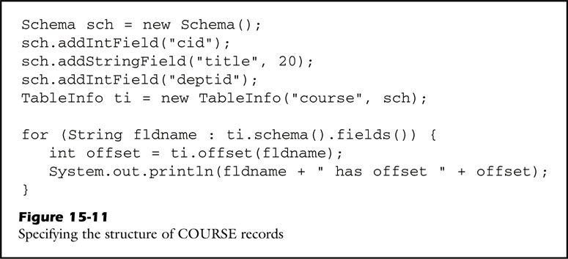
Create schema
Three field of COURSE table

Slide 15
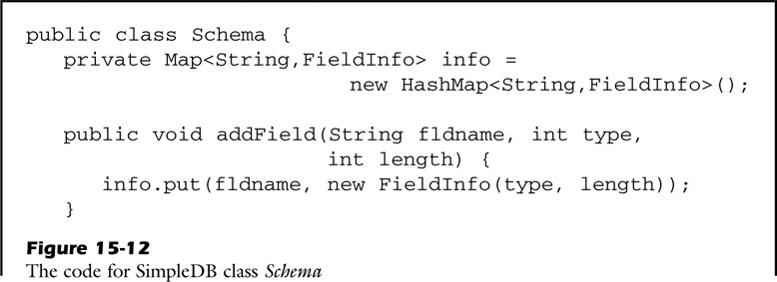
Implementing Schema and TableInfo
Single object
Store triple in a map
keyed on the field name

Slide 16
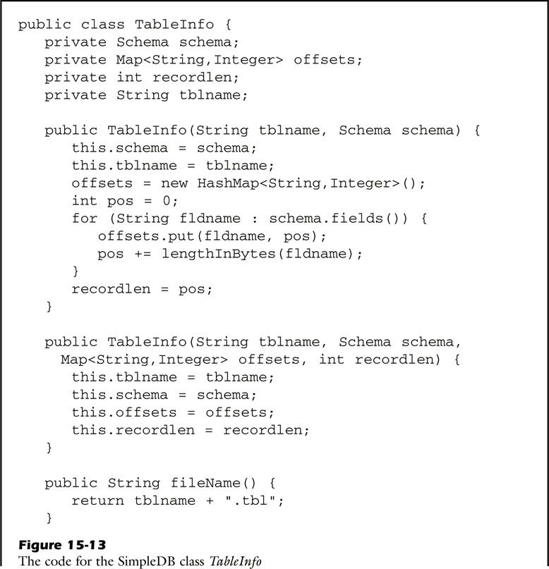
Calculate the offset
Calculate length of each field
Record length is sum of field length

Slide 17
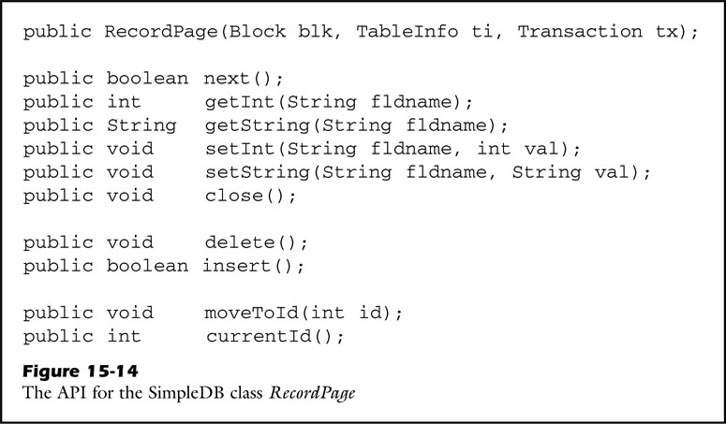
Managing record in a page
Move to next record, no more then return false
Get or set the value of a field
Delete a current record
Insert a blank record
Identifier

Slide 18
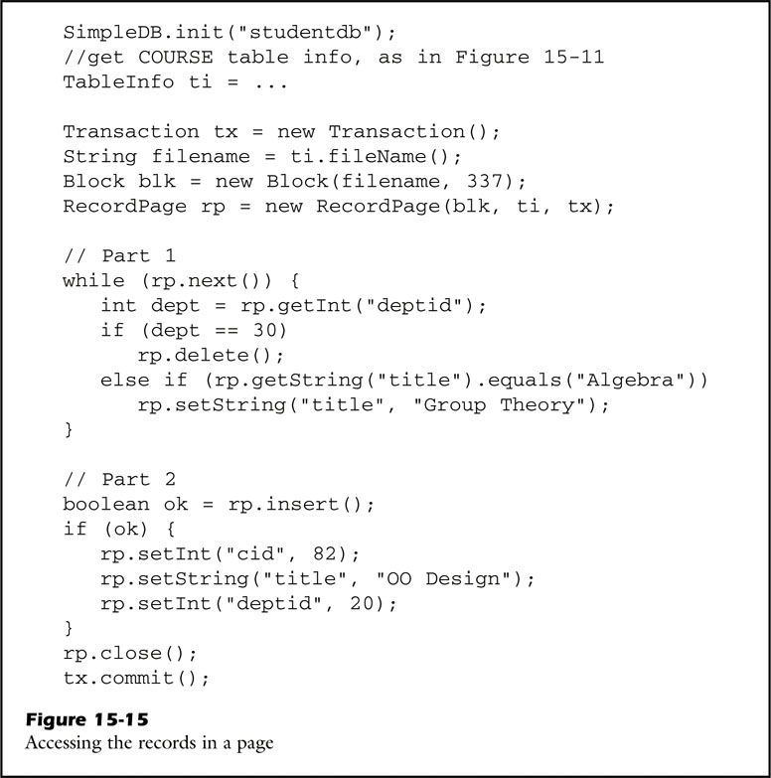
Examining block 337
Delete course by department id 30
Modify course tile from Algebra
to Group Theory
Insert a new record

Slide 19
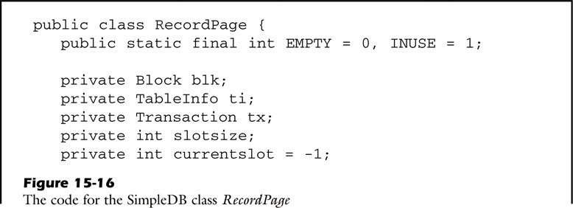
Implementing Record Pages
One slot before first slot in the page

Slide 20
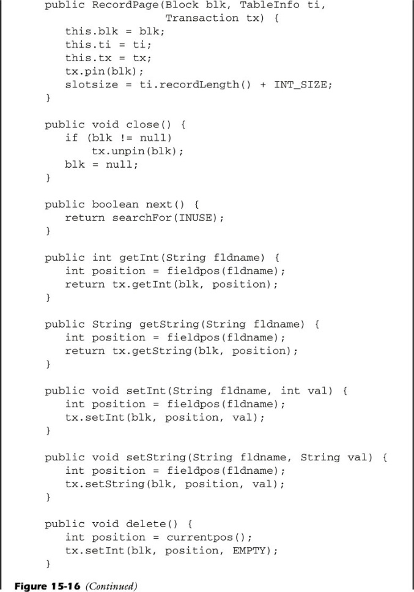
Unpin the buffer
tx
call method in the transaction
Parameter is different
Here： fieldname
Set flag of current record to EMPITY

Slide 21
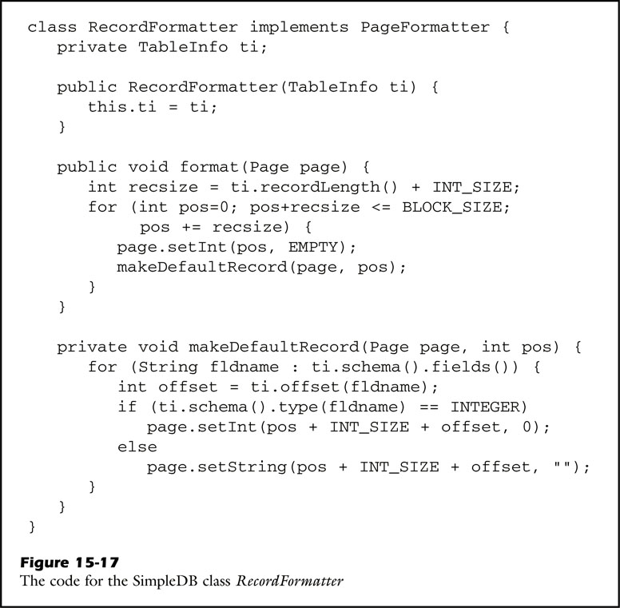
Formatting Record Pages
Set flag to EMPTY
Initializes every field to default value
Int to 0
String to “”

Slide 22
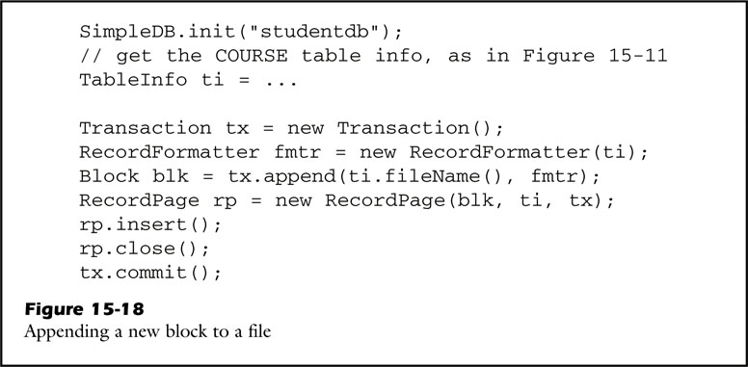
Transaction.append
Insert new record

Slide 23
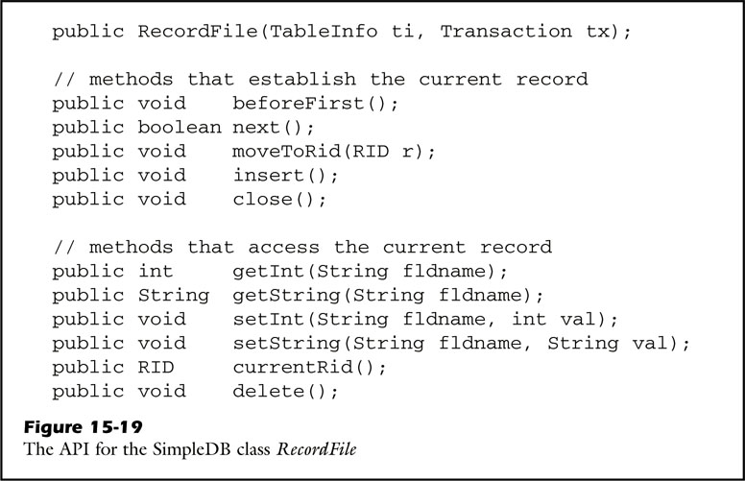
Managing record in a file
RecordFile hide block
Information for the
client
Record indentifier

Slide 24
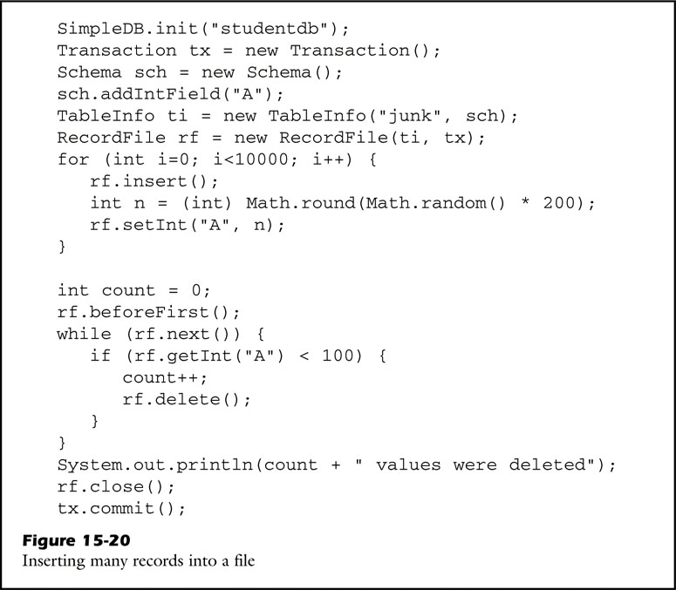
One filed A
A file junk
Insert 10,000 random value
Read all the record
Delete the record whose field value is less than 100

Slide 25
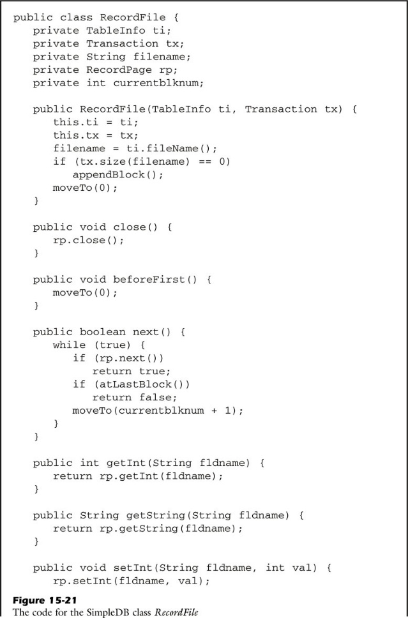
Implementing Record Files
next()
Move to next record in the current
record page
If there is no more record in that
page, then move to the next block of the
file and get its next record
Continue untuil either a next record is
found, or the end of the file is
encountered

Slide 26
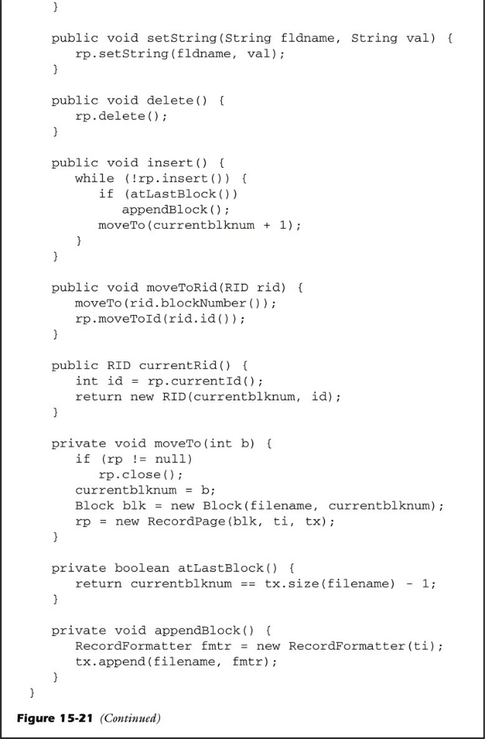
Insert a new record beginning at current block
If blocks all full, then append a new block
And insert the record

Slide 27
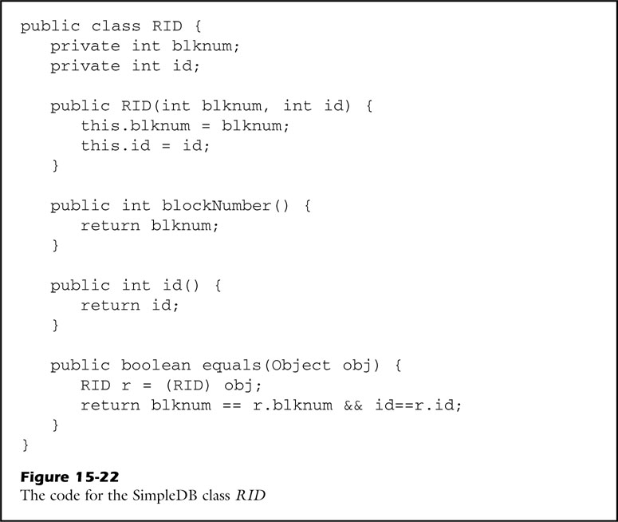
Block number
Record id

Slide 28
Q&A

